Slide 1
SQL PROJECT –
HOST BEHAVIOR ANALYSIS FOR PROPERTY RENTAL COMPANY

Slide 2

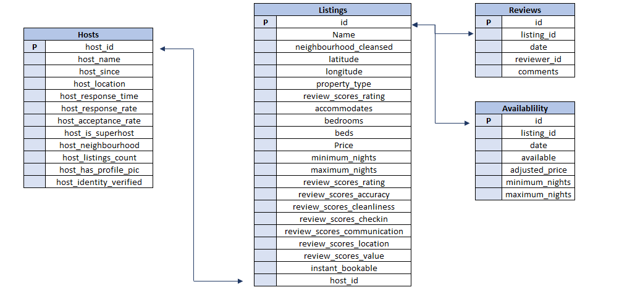
DATA OVERVIEW

Slide 3
PROJECT OVERVIEW-1
You are an Analyst working for a Property Rental company. The company wants to comprehend how the host behavior varies across a variety of metrics. The company Thus, you are asked to understand the data and come up with the below analysis:
a. Analyze different metrics to draw the distinction between Super Host and Other Hosts:
To achieve this, you can use the following metrics and explore a few yourself as well.
Acceptance rate, response rate, instant booking, profile picture, identity verified, review review scores, average no of bookings per month, etc.
b. Using the above analysis, identify top 3 crucial metrics one needs to maintain to become a Super Host and also, find their average values.
c. Analyze how does the comments of reviewers vary for listings of Super Hosts vs Other Hosts(Extract words from the comments provided by the reviewers)
d. Analyze do Super Hosts tend to have large property types as compared to Other Hosts

Slide 4
PROJECT OVERVIEW-2
e. Analyze the average price and availability of the listings for the upcoming year between Super Hosts and Other Hosts
f. Analyze if there is some difference in above mentioned trends between Local Hosts or Hosts residing in other locations
g. Analyze the above trends for the two cities for which data has been provided and provide insights on comparison
Provide your insights in an excel workbook, plot graphs and create multiple tabs as needed.

